Slide 1
Staying Data-Informed About Your Child
PTO Presentation
March 9, 2021
6PM

Slide 2
Welcome Elle Temple!

Slide 3
Why did we suggest changes?
Typically reviewed every 3 – 5 years
Revisions are only made when necessary
Revisions are subject to vote by the Board and then by the PTO
Ensure the bylaws are clearly written and allow flexibility

Slide 4
What changes are we recommending?
General Membership
“Membership” is open to all parents, guardians, teachers, and staff.
PTO meetings will be held regularly, generally one to two times per year.
A majority vote of those present at a PTO meeting is needed to pass a vote.

Slide 5
Changes to the current bylaws cont’d…
Board
The Board of the PTO will have no fewer than 9 members
President, President-Elect, Secretary, Treasurer, Assistant Treasurer, Principal, Vice Principal and 2 teacher liaisons.
There can be 2 presidents and 2 presidents-elect, if needed.
A majority of the Board members (min. of 5) constitutes a quorum.
Votes pass by a majority of those present.
Each role serves for 2 years except President, President-Elect, Treasurer and Assistant Treasurer, which are 1 year step-up roles.
Updated job descriptions to allow for more flexibility as needed year to year.
Two members of the same household cannot serve on the Board at the same time, however, they may co-chair a committee.

Slide 6
Let’s vote!!!!
Please vote that you APPROVE these bylaws as proposed by placing your vote in the chat.
A two-thirds vote is needed to pass these bylaws.

Slide 7
Objective
Share details with families regarding assessments and programs being utilized to measure student achievement and monitor student progress in order to keep our families data-informed and strengthen the home to school partnership.

Slide 8
Agenda
Assessment Details (MAP, Lexia, iReady)
Interpreting the data letter
What’s next?

Slide 9
Important Reminders
This data is just a snapshot
This is just one piece of the educational experience
We are all learning together
Our staff feel supported by you

Slide 10
MAP Testing
Occurs in August, January, and May to measure student achievement and growth throughout the school year.
Students take the MAP test in both reading and math.
MAP is a nationally-normed assessment taken by more than 11 million students in the United States each year.

Slide 11
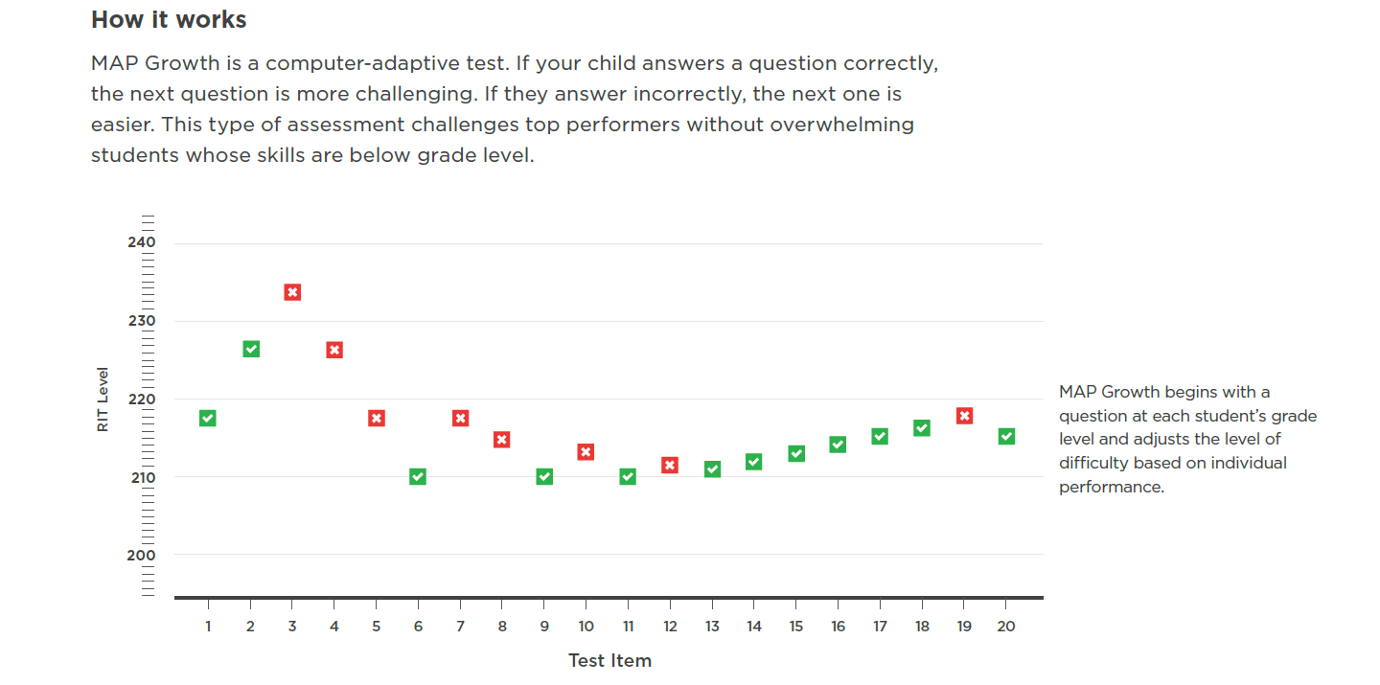
MAP Testing
Occurs in August, January, and May to measure student achievement and growth throughout the school year.
Students take the MAP test in both reading and math.
MAP is a nationally-normed assessment taken by more than 11 million students in the United States each year.

Slide 12
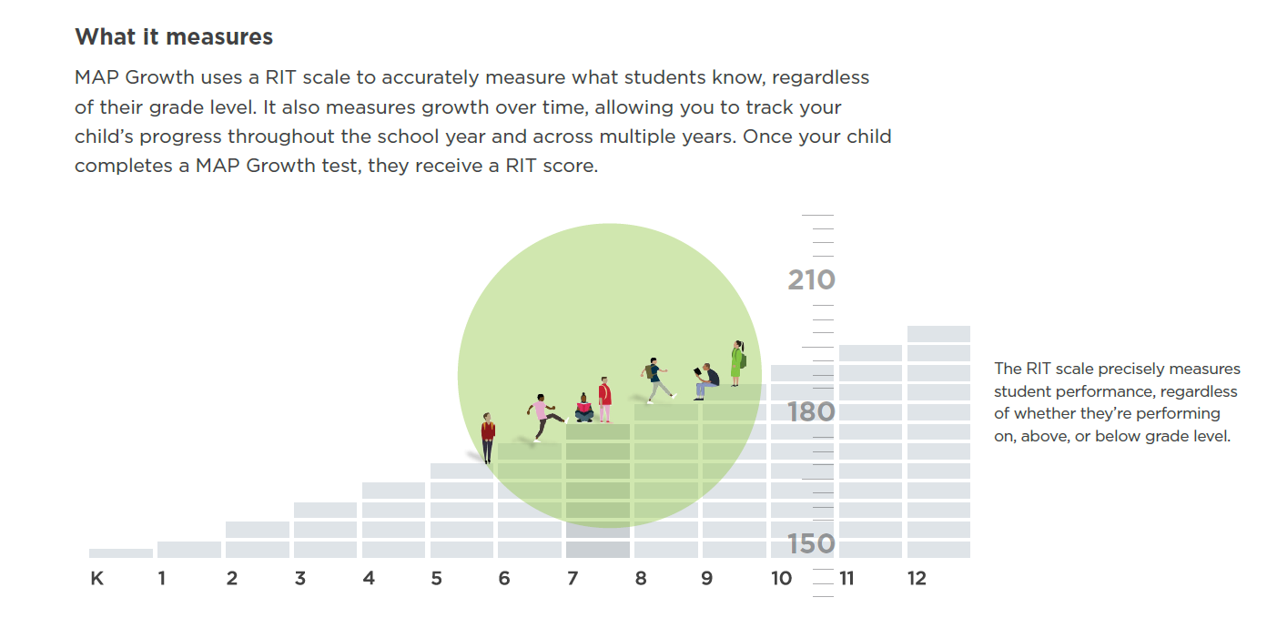
MAP Testing
Occurs in August, January, and May to measure student achievement and growth throughout the school year.
Students take the MAP test in both reading and math.
MAP is a nationally-normed assessment taken by more than 11 million students in the United States each year.

Slide 13
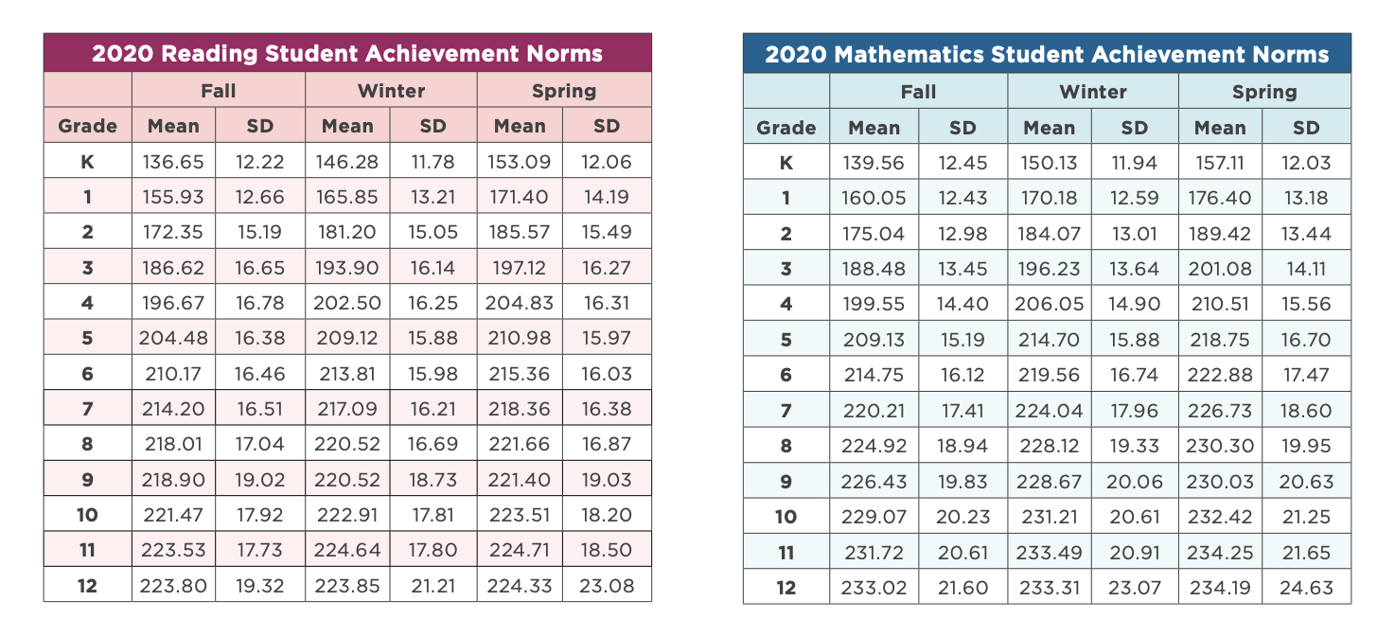
MAP Testing
Occurs in August, January, and May to measure student achievement and growth throughout the school year.
Students take the MAP test in both reading and math.
MAP is a nationally-normed assessment taken by more than 11 million students in the United States each year.

Slide 14
MAP Testing
Our goal for students: We want to see growth in student RIT scores throughout the year, showing they know more in May than they did in August.
Student RIT scores are assigned a national percentile rank. When students complete the August assessment, they are assigned a growth goal based on the national norms.
When students take the test again in January and May, their growth is also assigned a percentile rank relative to their nationally normed peers.
We want our students to grow at a rate that is equal to or exceeds their nationally normed peers.

Slide 15
Interpreting the Table
Literacy Measures
MAP – Reading (RIT score/National Percentile) |  | Aug RIT score | National Percentile | Jan RIT score | National Percentile
 |  | 200 | 84 | 209 | 85
Lexia Core-5 | Start Date | Starting Level | Total Units Completed | Current Level | Level Placement
Math Measures
MAP - Math (RIT score/National Percentile) |  | Aug RIT score | National Percentile | Jan RIT score | National Percentile
 |  | 201 | 80 | 220 | 94
iReady - Math |  | Diagnostic Date | Diagnostic Score | Lessons Completed | Level Placement

Slide 16
Interpreting the Table
Literacy Measures
MAP – Reading (RIT score/National Percentile) |  | Aug RIT score | National Percentile | Jan RIT score | National Percentile
 |  | 200 | 97 | 205 | 96
Lexia Core-5 | Start Date | Starting Level | Total Units Completed | Current Level | Level Placement
Math Measures
MAP - Math (RIT score/National Percentile) |  | Aug RIT score | National Percentile | Jan RIT score | National Percentile
 |  | 210 | 76 | 216 | 76
iReady - Math |  | Diagnostic Date | Diagnostic Score | Lessons Completed | Level Placement

Slide 17
MAP Testing – Teacher Resources
Class Report – analyze instructional needs for the class
Student profile – identify individual student areas of strength and focus. Identify areas where students are ready for further instruction
Learning Continuum – provides insight into instructional grouping based on identified student areas to develop.

Slide 18
Lexia Core 5
Computer-based program that helps develop reading skills in:
Phonological awareness
Phonics
Structural Analysis
Fluency
Vocabulary
Comprehension
http://www.lexialearning.com/

Slide 19
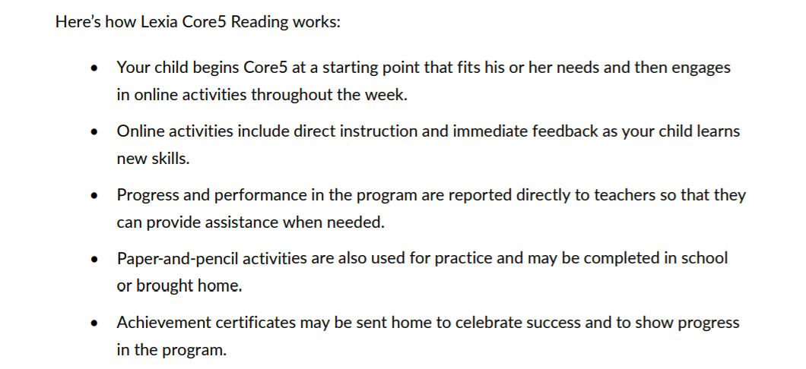
Lexia Core 5

Slide 20
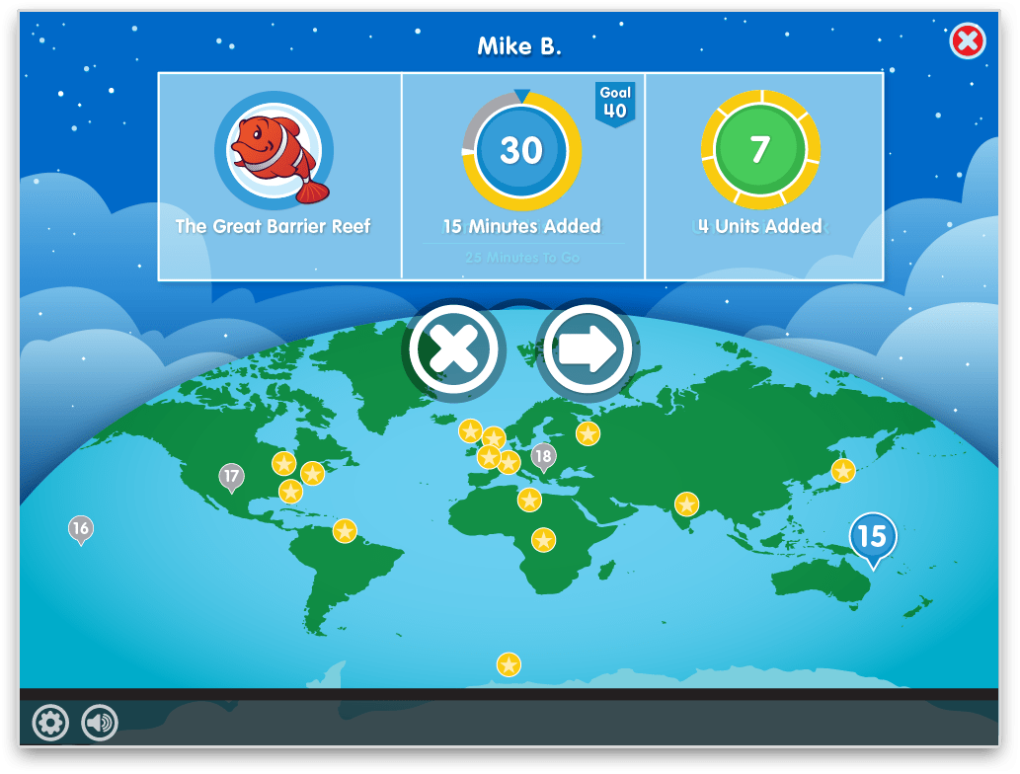
Lexia Core 5

Slide 21
Lexia Core 5

Slide 22
Lexia Core 5
Our goal: For students to show growth throughout the year by completing a level every 5-6 weeks.
Percy Priest Data since November
15% increase in students working above grade level
10% decrease in students working below grade level
http://www.lexialearning.com/

Slide 23
Interpreting the Table
Literacy Measures
MAP – Reading (RIT score/National Percentile) |  | Aug RIT score | National Percentile | Jan RIT score | National Percentile
Lexia Core-5 | Start Date | Starting Level | Total Units Completed | Current Level | Level Placement
 | 11/25/20 | 3 | 70 | 4 | In Student Grade
Math Measures
MAP - Math (RIT score/National Percentile) |  | Aug RIT score | National Percentile | Jan RIT score | National Percentile
iReady - Math |  | Diagnostic Date | Diagnostic Score | Lessons Completed | Level Placement

Slide 24
Interpreting the Table
Literacy Measures
MAP – Reading (RIT score/National Percentile) |  | Aug RIT score | National Percentile | Jan RIT score | National Percentile
Lexia Core-5 | Start Date | Starting Level | Total Units Completed | Current Level | Level Placement
 | 11/25/20 | 2 | 185 | 6 | Above Student Grade
Math Measures
MAP - Math (RIT score/National Percentile) |  | Aug RIT score | National Percentile | Jan RIT score | National Percentile
iReady - Math |  | Diagnostic Date | Diagnostic Score | Lessons Completed | Level Placement

Slide 25
Interpreting the Table
Literacy Measures
MAP – Reading (RIT score/National Percentile) |  | Aug RIT score | National Percentile | Jan RIT score | National Percentile
Lexia Core-5 | Start Date | Starting Level | Total Units Completed | Current Level | Level Placement
 | 11/25/20 | 6 | 30 | 7 | 1 Below
Math Measures
MAP - Math (RIT score/National Percentile) |  | Aug RIT score | National Percentile | Jan RIT score | National Percentile
iReady - Math |  | Diagnostic Date | Diagnostic Score | Lessons Completed | Level Placement

Slide 26
Lexia Core 5
Grade Level | Lexia Levels
PreK-K | 1-5
1st | 6-9
2nd | 10-12
3rd | 13-15
4th | 16-18
5th | 19-21
http://www.lexialearning.com/

Slide 27
Lexia Core 5 – Teacher Resources
Teacher Dashboard – view student progress and identify student’s who need minutes to reach their weekly goal.
Student Predictors – measures the likelihood of a student meeting the end of year benchmark based on current usage and progress in the program (updated monthly).
Struggling Students – flags students who are struggling to complete a lesson and in need of a teacher delivered support
Skill Builders – identifies students who have completed a level and are ready for skill building activities to support their learning
Certificates – recognizes students who have completed a level and the skills they have demonstrated as a result of completing the level.
http://www.lexialearning.com/

Slide 28
iReady
Begins with an adaptive diagnostic designed to:
Identify the specific skills each student needs to develop
Identify each student’s areas of strength
Measure academic growth through the school year.
Diagnostic covers four domains
Numbers and Operations
Algebra and Algebraic Thinking
Measurement and Data
Geometry

Slide 30
iReady
The diagnostic sets students on an individualized learning path.
As students complete lessons they will improve skills and progress through their path.
Students will complete the diagnostic again later this year. Similar to MAP, diagnostic results will provide insight into student growth.
Our goal: Students show growth throughout the year by completing lessons and increasing their diagnostic score.

Slide 31
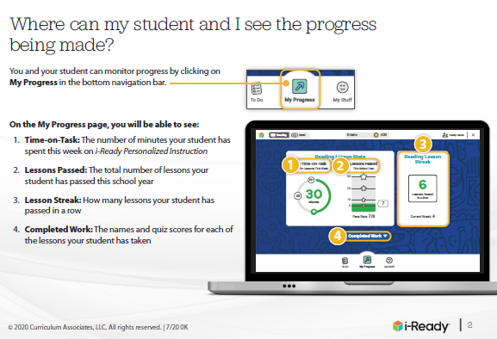
iReady

Slide 32
Interpreting the Table
Literacy Measures
MAP – Reading (RIT score/National Percentile) |  | Aug RIT score | National Percentile | Jan RIT score | National Percentile
Lexia Core-5 | Start Date | Starting Level | Total Units Completed | Current Level | Level Placement
Math Measures
MAP - Math (RIT score/National Percentile) |  | Aug RIT score | National Percentile | Jan RIT score | National Percentile
iReady - Math |  | Diagnostic Date | Diagnostic Score | Lessons Completed | Level Placement
 |  | 11/25/20 | 430 | 45 | Mid 1

Slide 33
Interpreting the Table
Literacy Measures
MAP – Reading (RIT score/National Percentile) |  | Aug RIT score | National Percentile | Jan RIT score | National Percentile
Lexia Core-5 | Start Date | Starting Level | Total Units Completed | Current Level | Level Placement
Math Measures
MAP - Math (RIT score/National Percentile) |  | Aug RIT score | National Percentile | Jan RIT score | National Percentile
iReady - Math |  | Diagnostic Date | Diagnostic Score | Lessons Completed | Level Placement
 |  | 11/25/20 | 430 | 4 | Mid 1

Slide 34
iReady – Teacher Resources
Instructional Grouping Report
Diagnostic Growth Report
Instructional Usage Summary

Slide 35
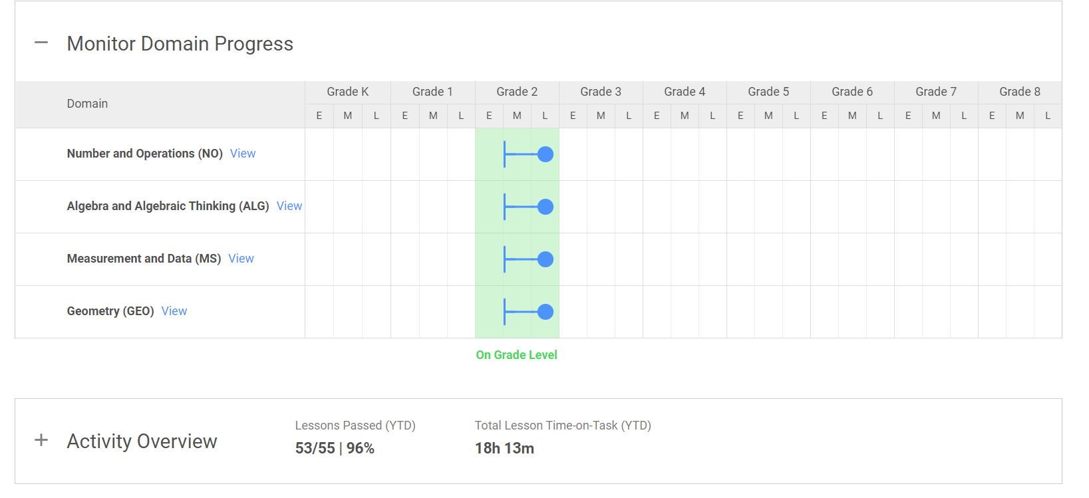
iReady – Teacher Resources
The diagnostic sets students on an individualized learning path.
As students complete lessons they will improve skills and progress through their path.
Students will complete the diagnostic again later this year. Similar to MAP, diagnostic results will provide insight into student growth.

Slide 36
What’s Next?
We encourage all students to complete 45 minutes every week for skills practice in both Lexia and iReady.
Spring parent conferences will occur on Friday, March 26th.
Check out some more family and parent resources to learn more about these assessments
https://www.nwea.org/the-map-suite/family-toolkit/
https://www.lexialearning.com/customer-resources/support-for-families
https://i-readycentral.com/familycenter/
Students will complete MAP testing in reading and math in May, as well as a diagnostic in iReady this spring. Encourage your student to do their best and celebrate their successes with us.

Slide 37
Staying Data-Informed About Your Child
PTO Presentation
March 9, 2021
6PM

